Slide 1
4th year project: Using Rfid/NFc for a Smart lock to improve home security
Sit Dolor Amet

Slide 2
Overview
What is this project?
My motivation and comparisons
Design
Implementation
Limitations
Result and Evaluation
How It can be improved

Slide 3
Introduction
What is the project about?
Why did I choose it?
Inspirations.

Slide 4
Design
Software | Hard-drive
Python | Raspberry pi 4
MYSQL + Web Development(HTML, PHP, CSS) | RFID reader and tag
BitVise | Cooling Fan

Slide 5
Design
Functional Requirement
RFID Reader must detect NFC key.
Reader should collect data into database.
Admin should be able to view and delete users who have access to the room.
Admin should get text message when user uses 3 attempt access.
Web server is only accessed by admin with the right code.
Non Functional
Web interface is visually appealing
Data analytics graph for specific user

Slide 6
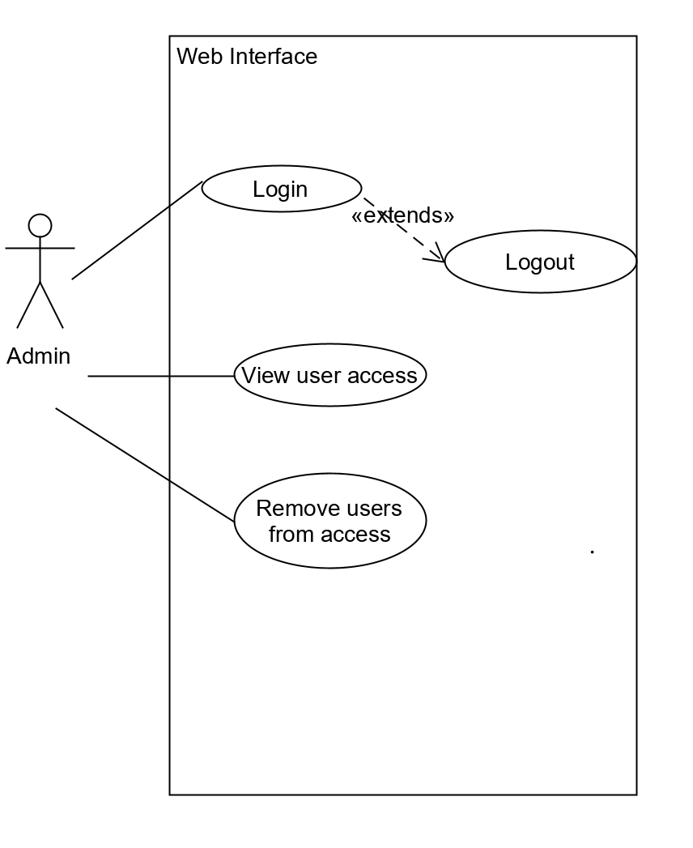
Design: UML Case Design

Slide 7
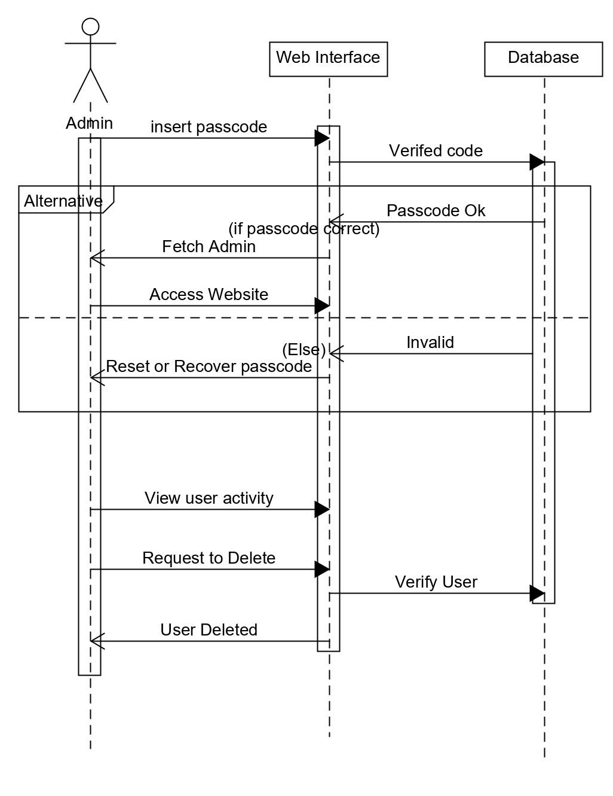

Slide 8
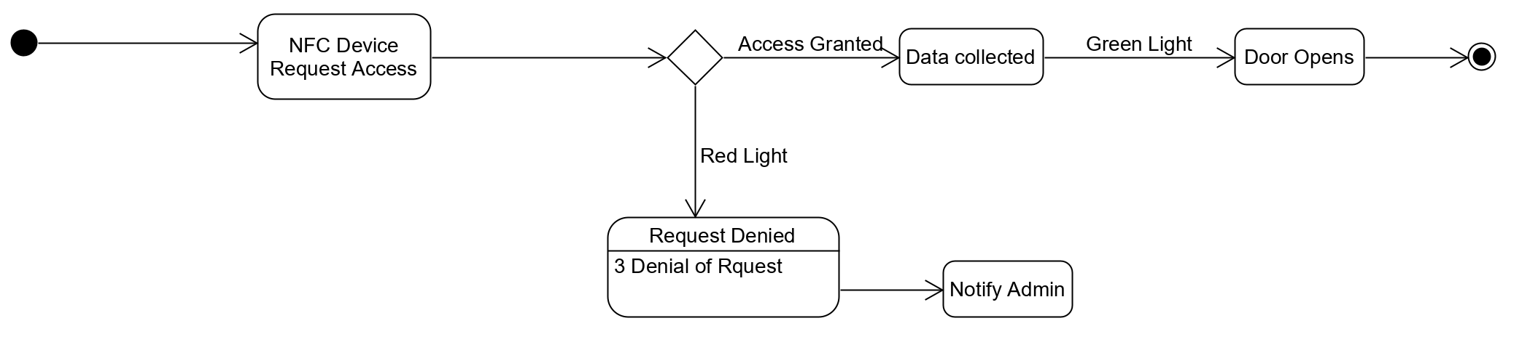
State Machine

Slide 9
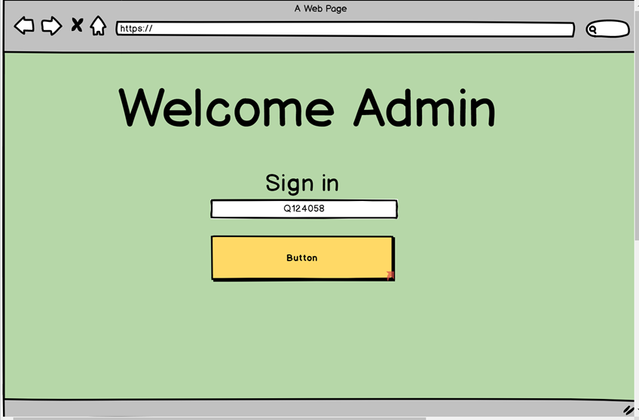
Login Page

Slide 10
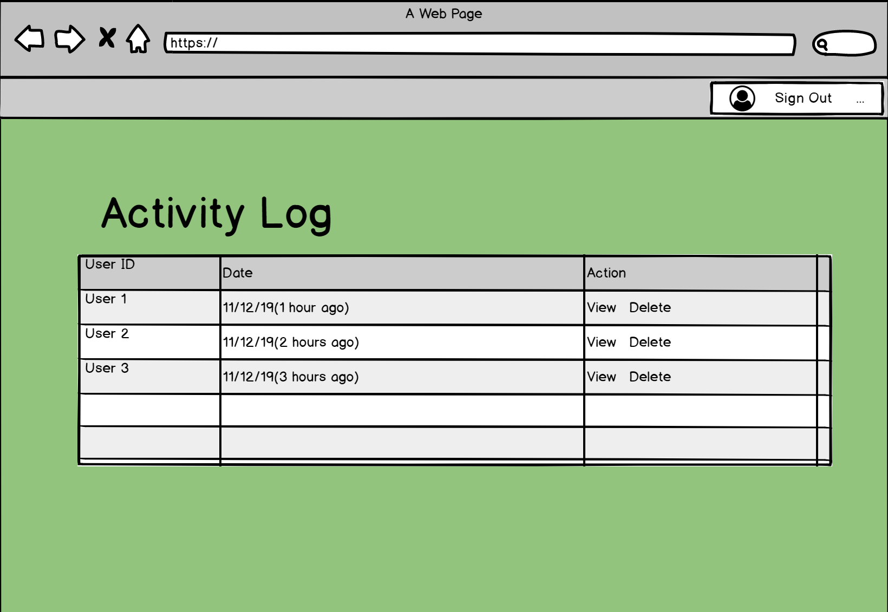
Home Page

Slide 11
Implementation: mySQL
pi@raspberrypi: ~$ sudo apt-get install mariab-server
pi@raspberrypi: ~$ sudo apt-get install apache2
pi@raspberrypi: ~$ sudo apt install php-mysql

Slide 12
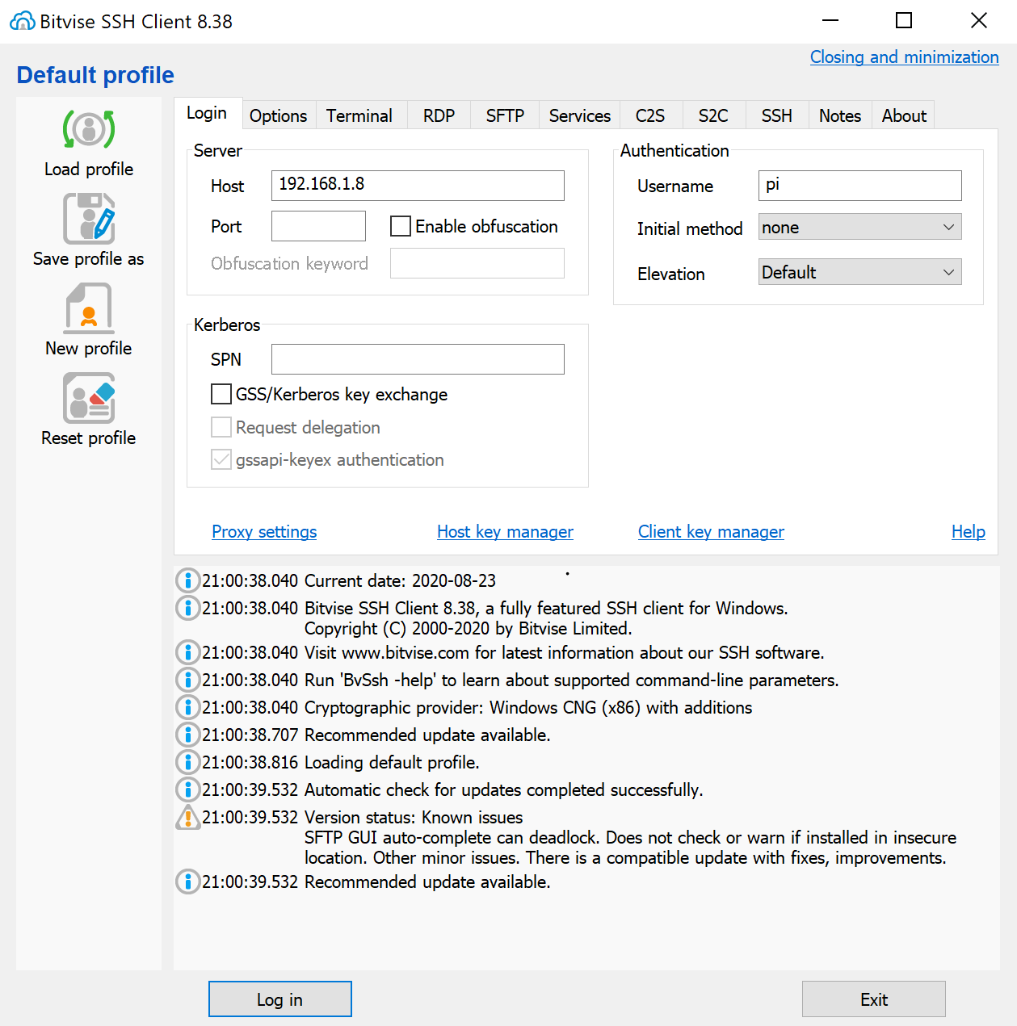
SSH Server: Bitvise
Used for ssh, Using the terminal of raspberry pi on my pc, for easier access.

Slide 13
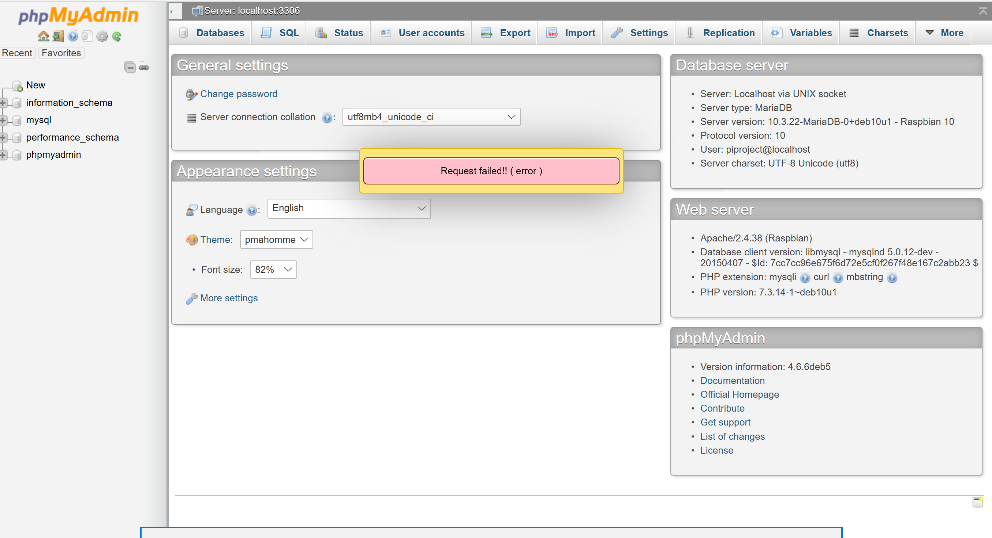
Implementation
pi@raspberrypi: ~$ sudo apt-get install phpMyAdmin
pi@raspberrypi: ~$ GRANT ALL PRIVILEGES ON *.* TO piproject@'localhost' IDENTIFIED BY 'projectpi' WITH GRANT OPTION;
nano /etc/apache2/apache2.conf
Include /etc/phpmyadmin/apache.conf

Slide 14
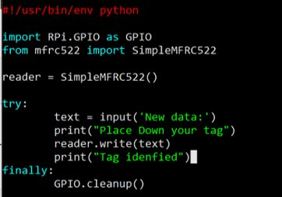
Implementation: RFID
sudo apt-get update
sudo apt-gupgrade
sudo apt-get install python3-dev python3-pip
sudo pip3 install spidev
sudo pip3 install mfrc522

Slide 15
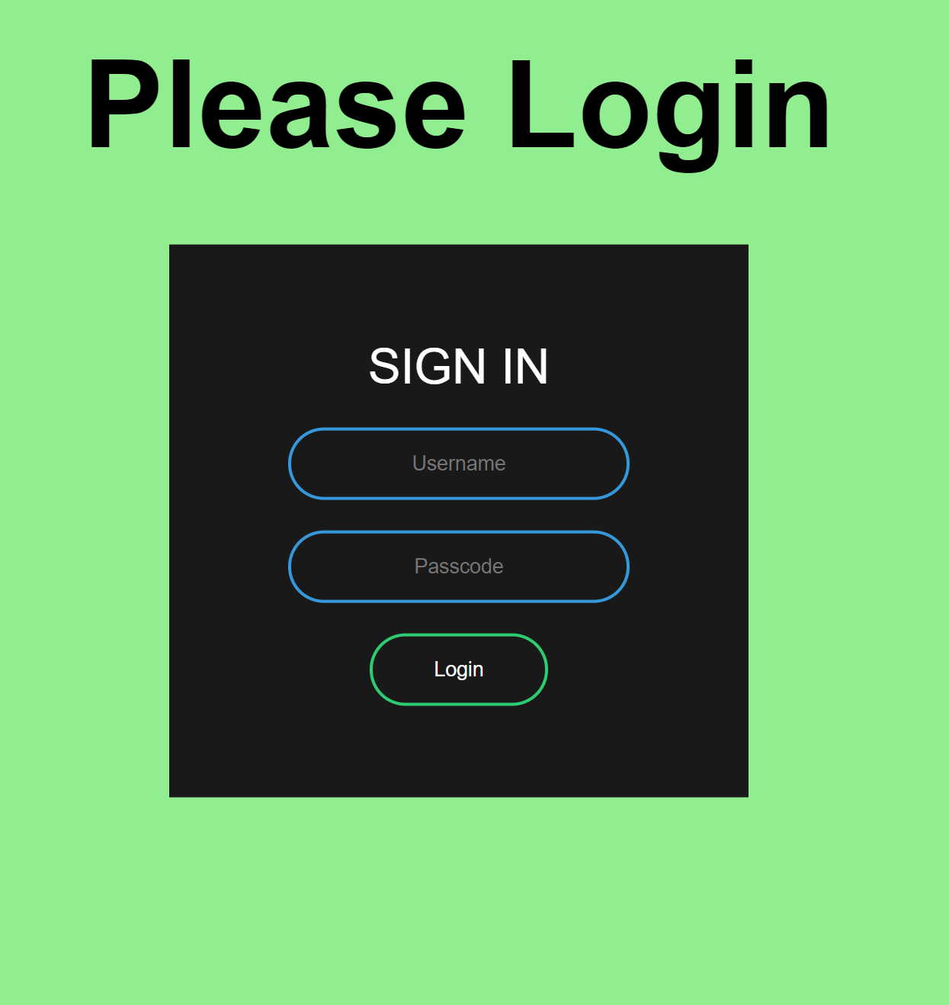
Login.php

Slide 16
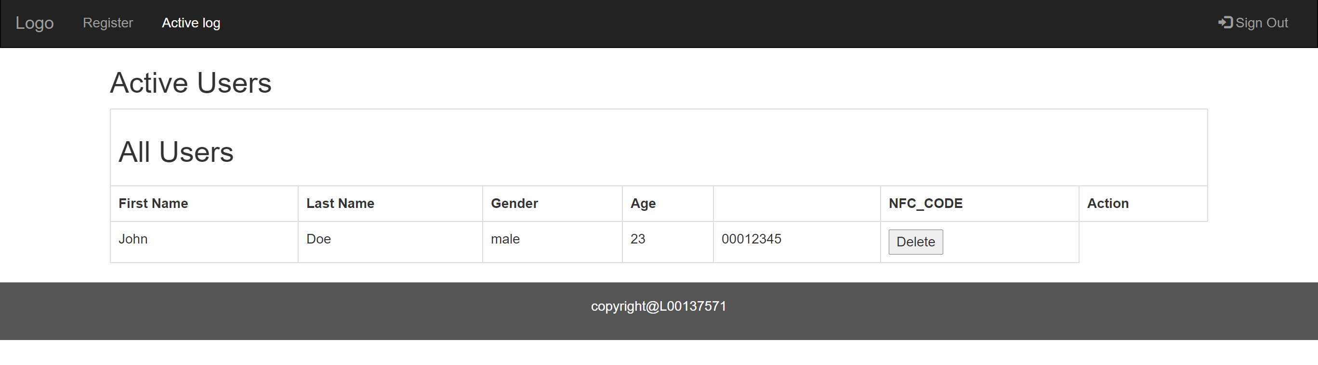
Home.php

Slide 17
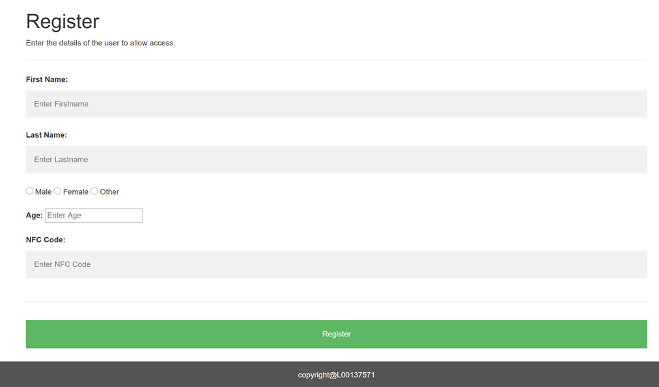
Register.php

Slide 18
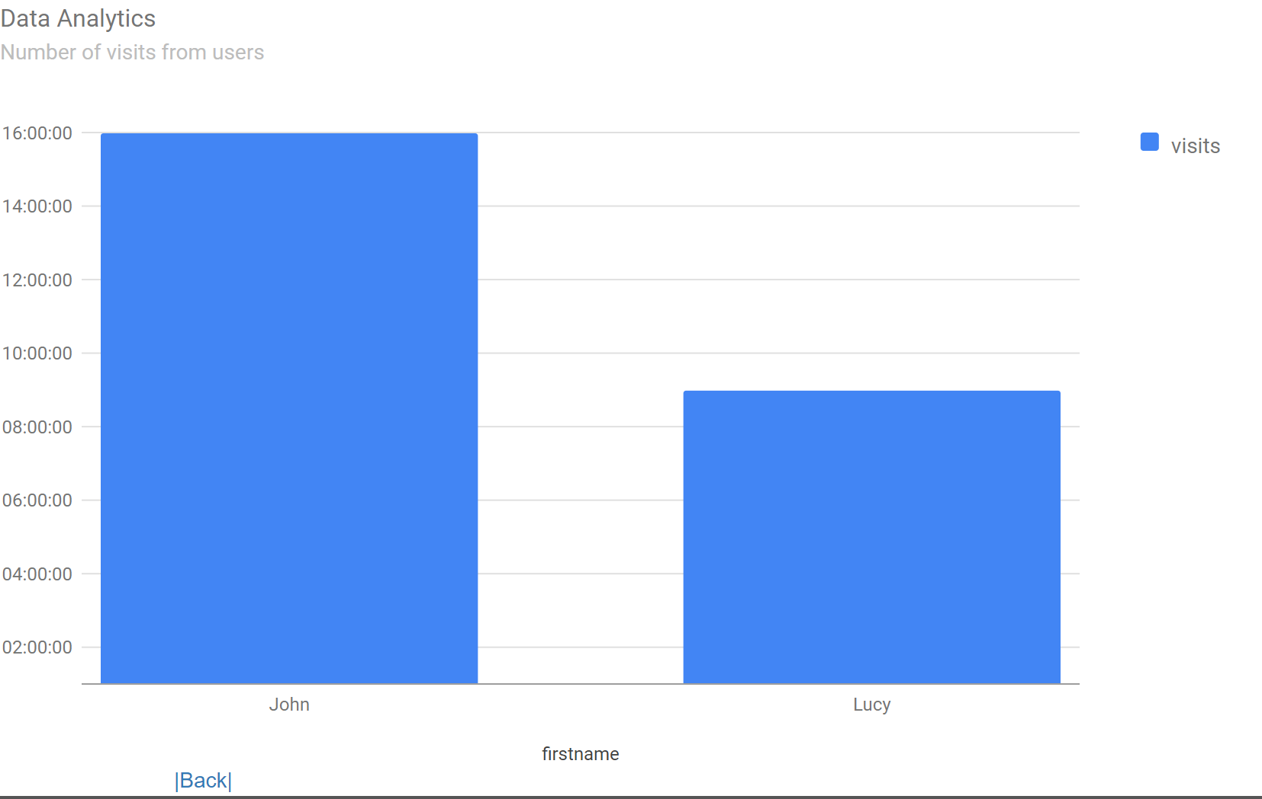
Dataanalytics.php

Slide 19
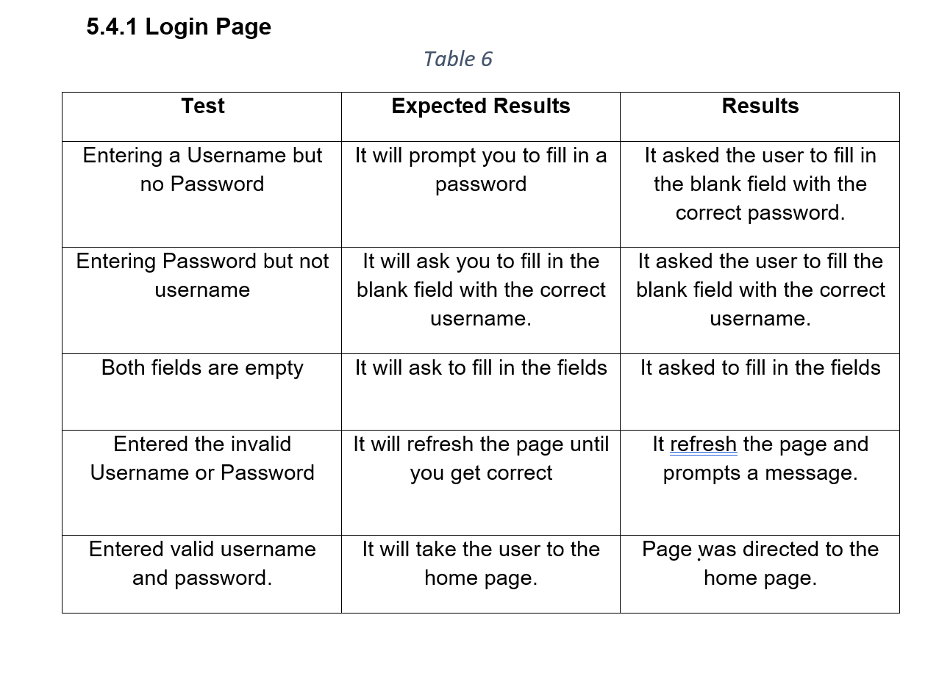
Tests

Slide 20
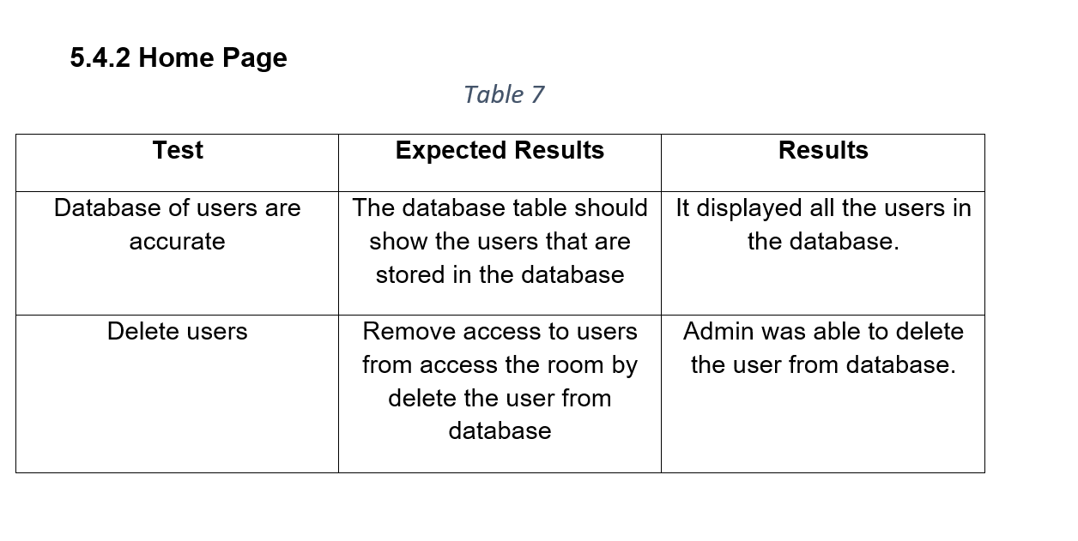

Slide 21
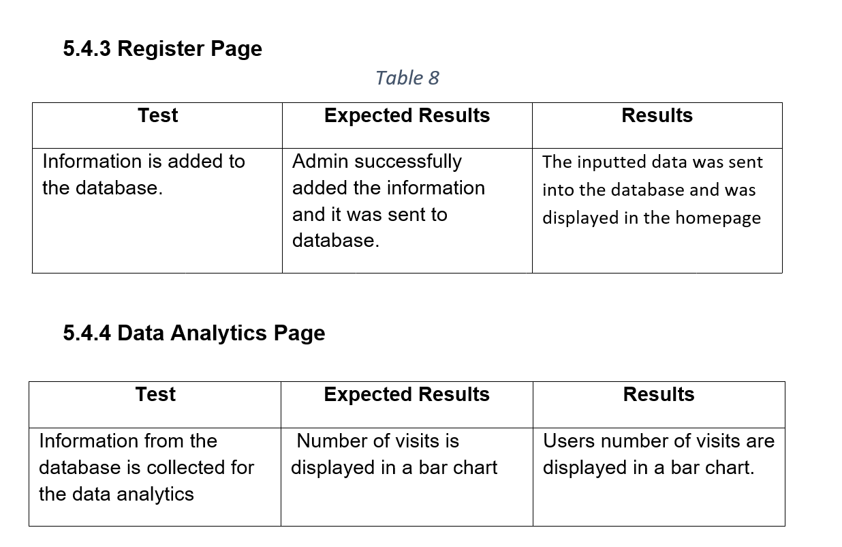

Slide 22
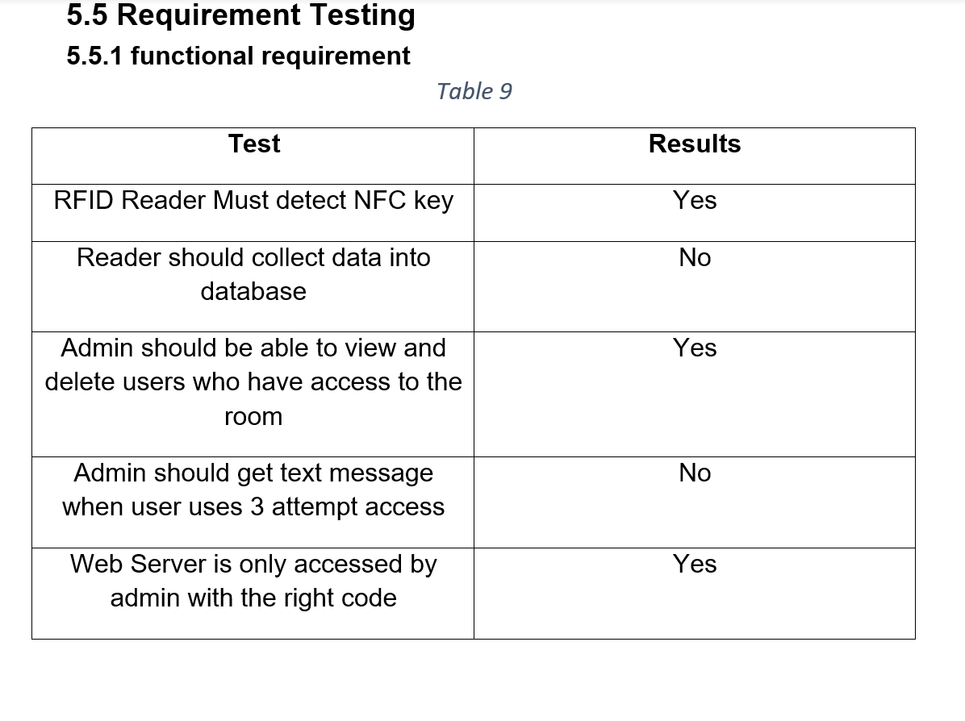

Slide 23
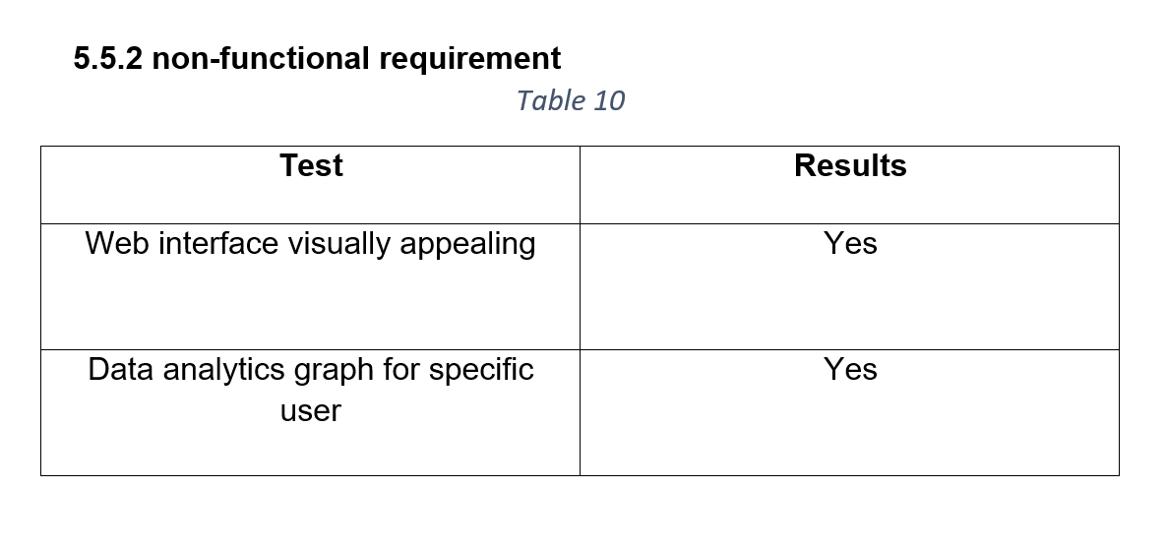

Slide 24
Limitation
RFID Reader Implementation
Phyton Knowledge

Slide 25
Conclusion
Most aims and objectives completed
Research question
What I learnt

Slide 26
Improvements
Use data analytics to view the behavioural patterns of users.
Implement the project using real world examples: Turn key implementation
Increase security: three factor authentication

